Slide 1
Computer Networks (CS-241)
Dr Syed Muhammad Mohsin
Department of Computer Science,
University of Wah
Adapted From:
Computer Networking: A Top-Down Approach 8th edition: Jim Kurose, Keith Ross Pearson, 2020

Slide 2

Chapter 3: roadmap
Transport-layer services
Multiplexing and demultiplexing
Connectionless transport: UDP
Principles of reliable data transfer
Connection-oriented transport: TCP
segment structure
reliable data transfer
flow control
connection management
Principles of congestion control
TCP congestion control

Slide 3
TCP: overview RFCs: 793,1122, 2018, 5681, 7323
cumulative ACKs
pipelining:
TCP congestion and flow control set window size
connection-oriented:
handshaking (exchange of control messages) initializes sender, receiver state before data exchange
flow controlled:
sender will not overwhelm receiver
point-to-point:
one sender, one receiver
reliable, in-order byte steam:
no “message boundaries"
full duplex data:
bi-directional data flow in same connection
Notes:
Typical MSS is 1460 bytes

Slide 4
TCP segment structure
32 bits
source port #
dest port #
segment seq #: counting bytes of data into byte stream (not segments!)
ACK: seq # of next expected byte; A bit: this is an ACK
sequence number
acknowledgement number
length (of TCP header)
head
len
not
used
A
P
S
receive window
flow control: # bytes receiver willing to accept
C
E
U
R
F
Internet checksum
checksum
Urg data pointer
options (variable length)
C, E: congestion notification
TCP options
application
data
(variable length)
data sent by application into TCP socket
RST, SYN, FIN: connection management

Slide 5
Chapter 3: roadmap
Transport-layer services
Multiplexing and demultiplexing
Connectionless transport: UDP
Principles of reliable data transfer
Connection-oriented transport: TCP
segment structure
reliable data transfer
flow control
connection management
Principles of congestion control
TCP congestion control

Slide 6

TCP flow control
application
process
Q: What happens if network layer delivers data faster than application layer removes data from socket buffers?
Application removing data from TCP socket buffers
TCP socket
receiver buffers
TCP
code
Network layer delivering IP datagram payload into TCP socket buffers
IP
code
from sender
receiver protocol stack
Notes:
(Presuming an intro)
Before diving into the details of TCP flow control, let’s first get the general context and motivate the need for flow control.
This diagram show a typical transport-layer implementation
A segment is brought up the protocol stack to the transport layer, and the segment’s payload is removed from the segment and written INTO socket buffers.
How does data get taken OUT of socket buffers? By applications performing socket reads, as we learned in Chapter 2.
And so the question is “What happens if network layer delivers data faster than an application-layer process removes data from socket buffers?”
Let’s watch a video of what happens when things arrive way too fast to fast to be processed.
<video>. (I love that video). Another human analogy showing the need for flow control is the saying – to use some English slang - “no one can drink from a firehose”
Flow control is a mechanism to the calamity of a receiver being over-run by a sender that is sending too fast – it allows the RECEIVER to explictly control the SENDER so sender won’t overflow receiver’s buffer by transmitting too much, too fast

Slide 7


TCP flow control
Q: What happens if network layer delivers data faster than application layer removes data from socket buffers?
application
process
Application removing data from TCP socket buffers
TCP socket
receiver buffers
TCP
code
Network layer delivering IP datagram payload into TCP socket buffers
IP
code
from sender
receiver protocol stack
What happens if the network layer delivers data into the socket buffers faster than the application layer removes data from the buffer through socket reads?
Notes:
(Presuming an intro)
Before diving into the details of TCP flow control, let’s first get the general context and motivate the need for flow control.
This diagram show a typical transport-layer implementation
A segment is brought up the protocol stack to the transport layer, and the segment’s payload is removed from the segment and written INTO socket buffers.
How does data get taken OUT of socket buffers? By applications performing socket reads, as we learned in Chapter 2.
And so the question is “What happens if network layer delivers data faster than an application-layer process removes data from socket buffers?”
Let’s watch a video of what happens when things arrive way too fast to fast to be processed.
<video>. (I love that video). Another human analogy showing the need for flow control is the saying – to use some English slang - “no one can drink from a firehose”
Flow control is a mechanism to the calamity of a receiver being over-run by a sender that is sending too fast – it allows the RECEIVER to explictly control the SENDER so sender won’t overflow receiver’s buffer by transmitting too much, too fast

Slide 8
TCP flow control
application
process
Q: What happens if network layer delivers data faster than application layer removes data from socket buffers?
Application removing data from TCP socket buffers
TCP socket
receiver buffers
TCP
code
receive window
flow control: # bytes receiver willing to accept
IP
code
from sender
receiver protocol stack
TCP segment format
Notes:
(Presuming an intro)
Before diving into the details of TCP flow control, let’s first get the general context and motivate the need for flow control.
This diagram show a typical transport-layer implementation
A segment is brought up the protocol stack to the transport layer, and the segment’s payload is removed from the segment and written INTO socket buffers.
How does data get taken OUT of socket buffers? By applications performing socket reads, as we learned in Chapter 2.
And so the question is “What happens if network layer delivers data faster than an application-layer process removes data from socket buffers?”
Let’s watch a video of what happens when things arrive way too fast to fast to be processed.
<video>. (I love that video). Another human analogy showing the need for flow control is the saying – to use some English slang - “no one can drink from a firehose”
Flow control is a mechanism to the calamity of a receiver being over-run by a sender that is sending too fast – it allows the RECEIVER to explictly control the SENDER so sender won’t overflow receiver’s buffer by transmitting too much, too fast

Slide 9
TCP flow control
application
process
Q: What happens if network layer delivers data faster than application layer removes data from socket buffers?
Application removing data from TCP socket buffers
TCP socket
receiver buffers
TCP
code
flow control
receiver controls sender, so sender won’t overflow receiver’s buffer by transmitting too much, too fast
IP
code
from sender
receiver protocol stack
Notes:
(Presuming an intro)
Before diving into the details of TCP flow control, let’s first get the general context and motivate the need for flow control.
This diagram show a typical transport-layer implementation
A segment is brought up the protocol stack to the transport layer, and the segment’s payload is removed from the segment and written INTO socket buffers.
How does data get taken OUT of socket buffers? By applications performing socket reads, as we learned in Chapter 2.
And so the question is “What happens if network layer delivers data faster than an application-layer process removes data from socket buffers?”
Let’s watch a video of what happens when things arrive way too fast to fast to be processed.
<video>. (I love that video). Another human analogy showing the need for flow control is the saying – to use some English slang - “no one can drink from a firehose”
Flow control is a mechanism to the calamity of a receiver being over-run by a sender that is sending too fast – it allows the RECEIVER to explictly control the SENDER so sender won’t overflow receiver’s buffer by transmitting too much, too fast

Slide 10
TCP flow control
TCP receiver “advertises” free buffer space in rwnd (receive window) field in TCP header
RcvBuffer size set via socket options (typical default is 4096 bytes)
many operating systems autoadjust RcvBuffer
sender limits amount of unACKed (“in-flight”) data to received rwnd
guarantees receive buffer will not overflow
to application process
RcvBuffer
buffered data
rwnd
free buffer space
TCP segment payloads
TCP receiver-side buffering
Here’s how TCP implements flow control. The basic idea is simple – the receiver informs the sender how much free buffer space there is, and the sender is limited to send no more than this amount of data. That the value o RWND in the diagram to the right.
Notes:
Here’s how TCP implement flow control. The basic idea is simple – the receiver informs the sender how much free buffer space there is, and the sender is limited to send no more than this amount of data. That the value o RWND in the diagram to the right.
This information is carried from the receiver to the sender in the “receiver advertised window” (do a PIP of header) in the TCP header, and the value will change as the amount of free buffer space fluctuates over time.

Slide 11
Chapter 3: roadmap
Transport-layer services
Multiplexing and demultiplexing
Connectionless transport: UDP
Principles of reliable data transfer
Connection-oriented transport: TCP
Principles of congestion control
TCP congestion control
Evolution of transport-layer functionality

Slide 12
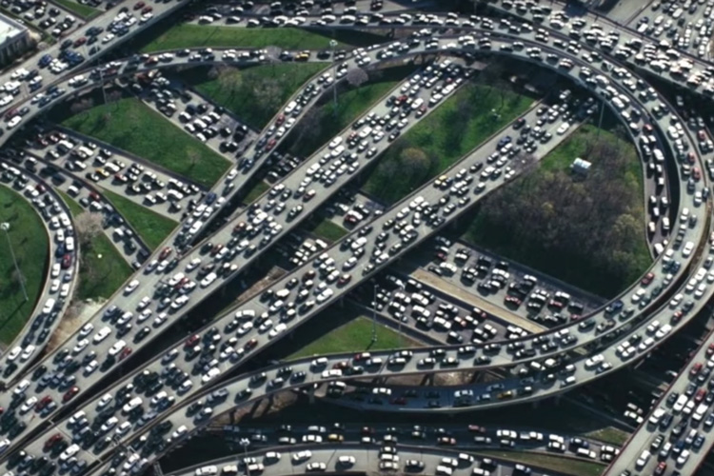
Principles of congestion control
Congestion:
informally: “too many sources sending too much data (packets) too fast for network to handle”
manifestations:
long delays (queueing in router buffers)
packet loss (buffer overflow at routers)
different from flow control! (Speed matching between single sender and single receiver)
congestion control: too many senders, sending too fast
a top-10 problem!
flow control: one sender too fast for one receiver

Slide 13
Causes/costs of congestion: scenario 1
Simplest scenario:
original data: λ_{in (flow rate)}
throughput: λ_{out (flow rate)}
one router, infinite buffers
input, output link capacity:
R bits/sec
Host A
infinite shared output link buffers
two flows
R
R
no retransmissions needed
Host B
R/2
Q: What happens as arrival rate λ_{in} approaches R/2?
λ_{out}
delay
throughput:
λ_{in}
R/2
λ_{in}
R/2
maximum per-connection throughput: R/2
large delays as arrival rate λ_{in} approaches capacity R
Throughput: How much data can pass through the network per second.
R/2

Slide 14
Causes/costs of congestion: scenario 2
one router, finite buffers
sender retransmits lost, timed-out packet
application-layer input = application-layer output: λ_{in} = λ_{out}
transport-layer input includes retransmissions : λ’_{in} λ_{in}
Host A
λ_{in} : original data
λ'_{in}: original data, plus retransmitted data
λ_{out}
R
R
Host B
finite shared output link buffers

Slide 15
Causes/costs of congestion: scenario 2
Idealization: perfect knowledge
sender sends only when router buffers available
R/2
λ_{out}
throughput:
Host A
λ_{in} : original data
λ_{in}
copy
λ'_{in}: original data, plus retransmitted data
λ_{out}
R/2
free buffer space!
R
R
Host B
finite shared output link buffers

Slide 16
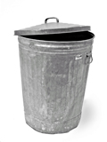
Causes/costs of congestion: scenario 2
Idealization: some perfect knowledge
packets can be lost (dropped at router) due to full buffers
sender knows when packet has been dropped: only resends if packet known to be lost
Host A
λ_{in} : original data
copy
λ'_{in}: original data, plus retransmitted data
no buffer space!
R
R
Host B
finite shared output link buffers

Slide 17
Causes/costs of congestion: scenario 2
Idealization: some perfect knowledge
packets can be lost (dropped at router) due to full buffers
sender knows when packet has been dropped: only resends if packet known to be lost
R/2
λ_{out}
“wasted” capacity due to retransmissions
when sending at R/2, some packets are needed retransmissions
throughput:
Host A
λ_{in} : original data
λ_{in}
λ'_{in}: original data, plus retransmitted data
R/2
free buffer space!
R
R
Host B
finite shared output link buffers

Slide 18


Causes/costs of congestion: scenario 2
Realistic scenario: un-needed duplicates
packets can be lost, dropped at router due to full buffers – requiring retransmissions
but sender times can time out prematurely, sending two copies, both of which are delivered
R/2
λ_{out}
“wasted” capacity due to un-needed retransmissions
throughput:
when sending at R/2, some packets are retransmissions, including needed and un-needed duplicates, that are delivered!
Host A
λ_{in} : original data
λ_{in}
copy
λ'_{in}: original data, plus retransmitted data
R/2
timeout
free buffer space!
R
R
Host B
finite shared output link buffers

Slide 19
Causes/costs of congestion: scenario 2
Realistic scenario: un-needed duplicates
packets can be lost, dropped at router due to full buffers – requiring retransmissions
but sender times can time out prematurely, sending two copies, both of which are delivered
R/2
λ_{out}
“wasted” capacity due to un-needed retransmissions
throughput:
when sending at R/2, some packets are retransmissions, including needed and un-needed duplicates, that are delivered!
λ_{in}
R/2
“costs” of congestion:
more work (retransmission) for given receiver throughput
unneeded retransmissions: link carries multiple copies of a packet
decreasing maximum achievable throughput

Slide 20
Causes/costs of congestion: scenario 3
four senders
multi-hop paths
timeout/retransmit
Q: what happens as λ_{in} and λ_{in}’ increase ?
A: as red λ_{in}’ increases, all arriving blue pkts at upper queue are dropped, blue throughput g 0
Host A
λ_{in} : original data
λ'_{in}: original data, plus retransmitted data
Host B
finite shared output link buffers
Host D
λ_{out}
Host C

Slide 21
Causes/costs of congestion: scenario 3
R/2
λ_{out}
λ_{in}’
R/2
another “cost” of congestion:
when packet dropped, any upstream transmission capacity and buffering used for that packet was wasted!

Slide 22
Causes/costs of congestion: insights
throughput can never exceed capacity
delay increases as capacity approached
loss/retransmission decreases effective throughput
un-needed duplicates further decreases effective throughput
upstream transmission capacity / buffering wasted for packets lost downstream

Slide 23
Approaches towards congestion control
End-end congestion control:
no explicit feedback from network
congestion inferred from observed loss, delay
ACKs
data
data
ACKs
approach taken by TCP

Slide 24
Approaches towards congestion control
Network-assisted congestion control:
routers provide direct feedback to sending/receiving hosts with flows passing through congested router
may indicate congestion level or explicitly set sending rate
explicit congestion info
ACKs
data
data
ACKs
TCP ECN, ATM, DECbit protocols

Slide 25
Chapter 3: roadmap
Transport-layer services
Multiplexing and demultiplexing
Connectionless transport: UDP
Principles of reliable data transfer
Connection-oriented transport: TCP
Principles of congestion control
TCP congestion control
Evolution of transport-layer functionality

Slide 26
TCP congestion control: AIMD
approach: senders can increase sending rate until packet loss (congestion) occurs, then decrease sending rate on loss event
Additive Increase
Multiplicative Decrease
increase sending rate by 1 maximum segment size every RTT until loss detected
cut sending rate in half at each loss event
AIMD sawtooth
behavior: probing
for bandwidth
TCP sender Sending rate
time

Slide 27
TCP AIMD: more
Multiplicative decrease detail: sending rate is
Cut in half on loss detected by triple duplicate ACK (TCP Reno)
Cut to 1 MSS (maximum segment size) when loss detected by timeout (TCP Tahoe)
Why AIMD?
AIMD – a distributed, asynchronous algorithm – has been shown to:
optimize congested flow rates network wide!
have desirable stability properties

Slide 28
TCP congestion control: details
sender sequence number space
TCP sending behavior:
roughly: send cwnd bytes, wait RTT for ACKS, then send more bytes
cwnd
last byte
ACKed
cwnd
sent, but not-yet ACKed
(“in-flight”)
available but not used
TCP rate
~
bytes/sec
~
RTT
last byte sent
TCP sender limits transmission:
cwnd is dynamically adjusted in response to observed network congestion (implementing TCP congestion control)
<
cwnd
LastByteSent- LastByteAcked

Slide 29
TCP slow start
Host A
Host B
when connection begins, increase rate exponentially until first loss event:
initially cwnd = 1 MSS
double cwnd every RTT
done by incrementing cwnd for every ACK received
one segment
RTT
two segments
four segments
summary: initial rate is slow, but ramps up exponentially fast
time

Slide 30
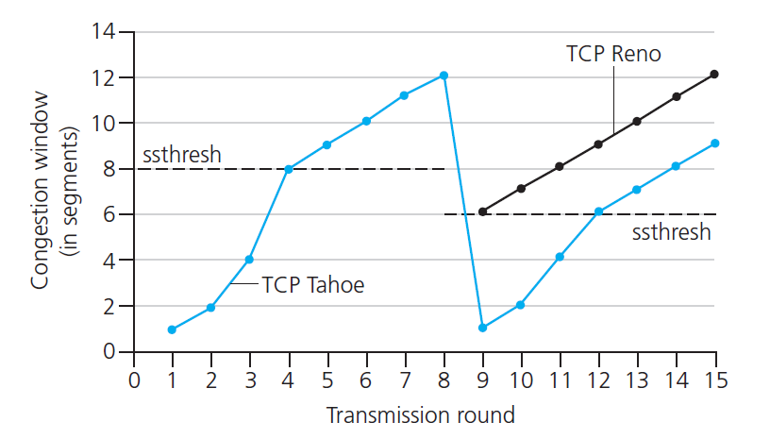

TCP: from slow start to congestion avoidance
Q: when should the exponential increase switch to linear?
A: when cwnd gets to 1/2 of its value before timeout.
X
Implementation:
variable ssthresh
on loss event, ssthresh is set to 1/2 of cwnd just before loss event
* Check out the online interactive exercises for more examples: http://gaia.cs.umass.edu/kurose_ross/interactive/

Slide 31
Summary: TCP congestion control
New
ACK!
New
ACK!
.
duplicate ACK
new ACK
dupACKcount++
new ACK
cwnd = cwnd + MSS (MSS/cwnd)
dupACKcount = 0
transmit new segment(s), as allowed
cwnd = cwnd+MSS
dupACKcount = 0
transmit new segment(s), as allowed
Λ
cwnd = 1 MSS
ssthresh = 64 KB
dupACKcount = 0
cwnd > ssthresh
slow
start
Λ
congestion
avoidance
timeout
ssthresh = cwnd/2
cwnd = 1 MSS
dupACKcount = 0
retransmit missing segment
duplicate ACK
timeout
dupACKcount++
ssthresh = cwnd/2
cwnd = 1 MSS
dupACKcount = 0
retransmit missing segment
timeout
New
ACK!
ssthresh = cwnd/2
cwnd = 1
dupACKcount = 0
retransmit missing segment
New ACK
dupACKcount == 3
cwnd = ssthresh
dupACKcount = 0
dupACKcount == 3
ssthresh= cwnd/2
cwnd = ssthresh + 3
retransmit missing segment
ssthresh= cwnd/2
cwnd = ssthresh + 3
retransmit missing segment
fast
recovery
duplicate ACK
cwnd = cwnd + MSS
transmit new segment(s), as allowed

Slide 32
TCP CUBIC
Is there a better way than AIMD to “probe” for usable bandwidth?
Insight/intuition:
W_{max}: sending rate at which congestion loss was detected
congestion state of bottleneck link probably (?) hasn’t changed much
after cutting rate/window in half on loss, initially ramp to to W_{max} faster, but then approach W_{max} more slowly
W_{max}
classic TCP
TCP CUBIC - higher throughput in this example
W_{max}/2

Slide 33
TCP CUBIC
K: point in time when TCP window size will reach W_{max}
K itself is tuneable
increase W as a function of the cube of the distance between current time and K
larger increases when further away from K
smaller increases (cautious) when nearer K
TCP CUBIC default in Linux, most popular TCP for popular Web servers
W_{max}
TCP Reno
TCP CUBIC
TCP
sending
rate
time
t₀
t₁
t₂
t₃
t₄

Slide 34
TCP and the congested “bottleneck link”
TCP (classic, CUBIC) increase TCP’s sending rate until packet loss occurs at some router’s output: the bottleneck link
source
destination
application
TCP
network
link
physical
application
TCP
network
link
physical
packet queue almost never empty, sometimes overflows packet (loss)
bottleneck link (almost always busy)

Slide 35
TCP and the congested “bottleneck link”
TCP (classic, CUBIC) increase TCP’s sending rate until packet loss occurs at some router’s output: the bottleneck link
understanding congestion: useful to focus on congested bottleneck link
insight: increasing TCP sending rate will not increase end-end throughout with congested bottleneck
source
destination
application
TCP
network
link
physical
application
TCP
network
link
physical
insight: increasing TCP sending rate will increase measured RTT
Goal: “keep the end-end pipe just full, but not fuller”
RTT

Slide 36
Delay-based TCP congestion control
Keeping sender-to-receiver pipe “just full enough, but no fuller”: keep bottleneck link busy transmitting, but avoid high delays/buffering
# bytes sent in last RTT interval
RTT_{measured}
measured
throughput
=
RTT_{measured}
Delay-based approach:
RTT_{min} - minimum observed RTT (uncongested path)
uncongested throughput with congestion window cwnd is cwnd/RTT_{min}
if measured throughput “very close” to uncongested throughput
increase cwnd linearly /* since path not congested */
else if measured throughput “far below” uncongested throughout
decrease cwnd linearly /* since path is congested */

Slide 37
Delay-based TCP congestion control
congestion control without inducing/forcing loss
maximizing throughout (“keeping the just pipe full… ”) while keeping delay low (“…but not fuller”)
a number of deployed TCPs take a delay-based approach
BBR deployed on Google’s (internal) backbone network

Slide 38
Explicit congestion notification (ECN)
TCP deployments often implement network-assisted congestion control:
two bits in IP header (ToS field) marked by network router to indicate congestion
policy to determine marking chosen by network operator
congestion indication carried to destination
destination sets ECE bit on ACK segment to notify sender of congestion
involves both IP (IP header ECN bit marking) and TCP (TCP header C,E bit marking)
source
TCP ACK segment
destination
application
TCP
network
link
physical
application
TCP
network
link
physical
ECE=1
ECN=10
ECN=11
IP datagram

Slide 39
Difference Between TCP and UDP
TCP (Transmission Control Protocol) | UDP (User Datagram Protocol)
Connection-oriented protocol | Connectionless protocol
Reliable; guarantees delivery | Unreliable; no delivery guarantee
Ensures data arrives in order | No guarantee of order
Slower due to overhead | Faster and lightweight
Performs error control with retransmission | Error detection only; no retransmission
Has flow control and congestion control | No flow or congestion control
Larger header size (20 bytes) | Smaller header size (8 bytes)
Used for web, email, file transfer (HTTP, FTP, SMTP) | Used for online games, VoIP, streaming, DNS

Slide 40
Additional slides

Slide 41
TCP fairness
Fairness goal: if K TCP sessions share same bottleneck link of bandwidth R, each should have average rate of R/K
TCP connection 1
bottleneck
router
capacity R
TCP connection 2

Slide 42
Q: is TCP Fair?
Example: two competing TCP sessions:
additive increase gives slope of 1, as throughout increases
multiplicative decrease decreases throughput proportionally
R
equal bandwidth share
Is TCP fair?
A: Yes, under idealized assumptions:
same RTT
fixed number of sessions only in congestion avoidance
loss: decrease window by factor of 2
congestion avoidance: additive increase
Connection 2 throughput
loss: decrease window by factor of 2
congestion avoidance: additive increase
Connection 1 throughput
R

Slide 43
Fairness: must all network apps be “fair”?
Fairness and UDP
multimedia apps often do not use TCP
do not want rate throttled by congestion control
instead use UDP:
send audio/video at constant rate, tolerate packet loss
there is no “Internet police” policing use of congestion control
Fairness, parallel TCP connections
application can open multiple parallel connections between two hosts
web browsers do this , e.g., link of rate R with 9 existing connections:
new app asks for 1 TCP, gets rate R/10
new app asks for 11 TCPs, gets R/2

Slide 44
TCP throughput
avg. TCP thruput as function of window size, RTT?
ignore slow start, assume there is always data to send
W: window size (measured in bytes) where loss occurs
avg. window size (# in-flight bytes) is ¾ W
avg. thruput is 3/4W per RTT
avg TCP thruput =
3
W
4
RTT
bytes/sec
W
W/2

Slide 45
TCP connection management
before exchanging data, sender/receiver “handshake”:
agree to establish connection (each knowing the other willing to establish connection)
agree on connection parameters (e.g., starting seq #s)
application
application
connection state: ESTAB
connection variables:
seq # client-to-server
server-to-client
rcvBuffer size
at server,client
connection state: ESTAB
connection Variables:
seq # client-to-server
server-to-client
rcvBuffer size
at server,client
network
network
Socket clientSocket =
newSocket("hostname","port number");
Socket connectionSocket = welcomeSocket.accept();
Notes:
The other TCP topic we’ll want to consider here is that of “connection management”
The TCP sender and reciver have a number of pieces of shared state that they must establish before actually communication
FIRST theym ust both agree that they WANT to communicate with each other
Secondly there are connection parameters – the initial sequence number and the initial receiver-advertised bufferspace that they’ll want to agree on
This is done via a so-called handshake protocol – the client reaching our to the server, and the server answering back.
And before diving into the TCP handshake protocol, let’s first consider the problem of handshaking, of establishing shared state.

Slide 46


Agreeing to establish a connection
2-way handshake:
Q: will 2-way handshake always work in network?
variable delays
retransmitted messages (e.g. req_conn(x)) due to message loss
message reordering
can’t “see” other side
Let’s talk
ESTAB
OK
ESTAB
choose x
req_conn(x)
ESTAB
acc_conn(x)
ESTAB
Notes:
Here’s an example of a two way handshake. Alice reaches out to Bob and say’s “let’s talk” and Bob says OK, and they start their conversation
For a network protocol, the equivalent protocol would be a client sending a “request connection” message saying ”let’s talk, the initial sequence number is x”
And the server would respond with a message ”I accept your connect x”
And the question we want to ask ourselves is <talk through>
Will this work? Let’s look at a few scenarios…

Slide 47

2-way handshake scenarios
choose x
req_conn(x)
ESTAB
acc_conn(x)
ESTAB
data(x+1)
accept
data(x+1)
ACK(x+1)
connection
x completes
No problem!

Slide 48

2-way handshake scenarios
choose x
req_conn(x)
ESTAB
retransmit
req_conn(x)
acc_conn(x)
ESTAB
req_conn(x)
connection
x completes
client terminates
server
forgets x
ESTAB
acc_conn(x)
Problem: half open connection! (no client)

Slide 49
2-way handshake scenarios
choose x
req_conn(x)
ESTAB
retransmit
req_conn(x)
acc_conn(x)
ESTAB
data(x+1)
accept
data(x+1)
retransmit
data(x+1)
connection
x completes
client terminates
server
forgets x
req_conn(x)
ESTAB
data(x+1)
accept
data(x+1)
Problem: dup data
accepted!

Slide 50
TCP 3-way handshake
Server state
Client state
serverSocket = socket(AF_INET,SOCK_STREAM)
serverSocket.bind((‘’,serverPort))
serverSocket.listen(1)
connectionSocket, addr = serverSocket.accept()
clientSocket = socket(AF_INET, SOCK_STREAM)
LISTEN
clientSocket.connect((serverName,serverPort))
LISTEN
choose init seq num, x
send TCP SYN msg
SYNSENT
SYNbit=1, Seq=x
choose init seq num, y
send TCP SYNACK
msg, acking SYN
SYN RCVD
SYNbit=1, Seq=y
ACKbit=1; ACKnum=x+1
received SYNACK(x)
indicates server is live;
send ACK for SYNACK;
this segment may contain
client-to-server data
ESTAB
ACKbit=1, ACKnum=y+1
received ACK(y)
indicates client is live
ESTAB
Notes:
TCP’s three way handshake, that operates as follows
Let’s say the client and server both create a TCP socket as we learned about in Chapter 2 and enter the LISTEN state
The client then connects to the server sending a SYN message with a sequence number x (SYN Message is an TCP Segment with SYN but set in the header – you might want to go back and review the TCP segment format!)
The server is waiting for a connection, and receives the SYN message enters the SYN received state (NOT the established state and sends a SYN ACK message back.
Finally the client sends an ACK message to the server, and when the server receiver this enters the ESTABLished state. This is when the application process would see the return from the wait on the socket accept() call

Slide 51
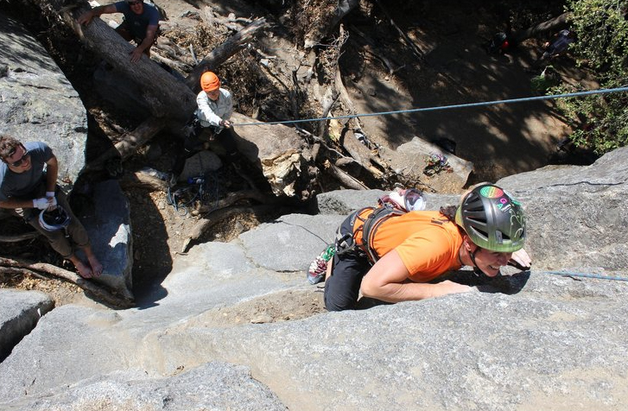
A human 3-way handshake protocol
1. On belay?
2. Belay on.
3. Climbing.
Notes:
As usual, there’s a human protocol analogy to the three way handshake, and I still remember thinking about this clinging for my life while climbing up a rockface
When you want start climbing you first say ON BELOW (meaning ARE YOU READY WITH MY SAFETY ROPE)
THE BELYER (server) responds BELAY ON (that lets you know the belayer is ready for you)
And then you say CLIMING
It’s amazing what can pass through your head when your clinging for your life o a

Slide 52
Closing a TCP connection
client, server each close their side of connection
send TCP segment with FIN bit = 1
respond to received FIN with ACK
on receiving FIN, ACK can be combined with own FIN
simultaneous FIN exchanges can be handled
Notes:
All good things must come to an end, and that’s true for a TCP connection as well.
And of course there’s a protocol for one side to gracefully close of a TCP connection using a FIN message, to which the other side sends a FINACK message and waits around a bit to respond to any retransmitted FIN messages before timing out.

Slide 53
Closing a TCP connection
client state
server state
ESTAB
ESTAB
clientSocket.close()
FIN_WAIT_1
can no longer
send but can
receive data
FINbit=1, seq=x
CLOSE_WAIT
ACKbit=1; ACKnum=x+1
can still
send data
FIN_WAIT_2
wait for server
close
LAST_ACK
FINbit=1, seq=y
TIMED_WAIT
can no longer
send data
ACKbit=1; ACKnum=y+1
timed wait
for 2*max
segment lifetime
CLOSED
CLOSED

